Slide 1
Compiler Construction
Mukesh Kumar Tripathi
Assistant Professor
Department of Information Technology
Vasavi College of Engineering

Slide 2
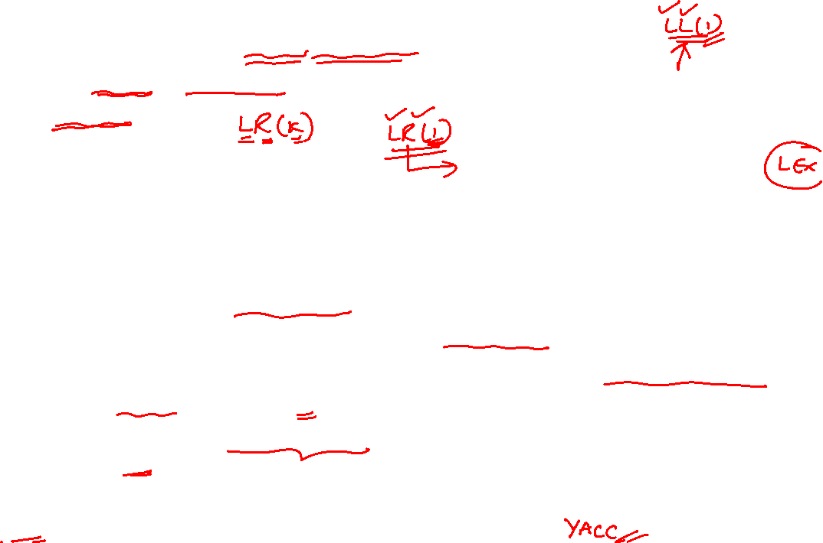

LR Parsers
LR parsing is an efficient, bottom-up syntax analysis technique that can be used to parse a large class of CFGs.
LR(k) parsing:
L: Left to right scanning of the input
R: Producing a rightmost derivation in reverse
k: Number of input symbols of lookahead that are used in making parsing
decisions. (k is omitted ➔ it is 1)
LR parsing is attractive because:
LR parsing is most general non-backtracking shift-reduce parsing
The class of grammars that can be parsed using LR methods is a proper superset of the class of grammars that can be parsed with predictive parsers. LL(1)-Grammars ⊂ LR(1)-Grammars
An LR-parser can detect a syntactic error as soon as it is possible to do so a left-to-right scan of the input.
The principal drawback of the LR method is that it is too much work to construct an LR parser by hand for a typical programming language grammar.

Slide 3
Model of an LR Parser
input
a₁ | a₂ | … | a_{i} | … | a_{n} | $
stack
LR Parsing Program (driver)
s_{m}
X_{m}
s_{m-1}
X_{m-1}
…
s₀
output
ACTION Table terminals and $ s t four different a actions t e s | GOTO Table non-terminal s t each item is a a state number t e s
S_{m} and a_{i} decides the parser action by consulting the parsing action table. (Initial Stack contains just S_{o} )
Notes:
ACTION table is indexed by state and terminal symbols.
GOTO table is indexed by state and non terminal symbols.

Slide 4
LR parsing Algorithm
Input: An input string w, and an LR-Parsing table with functions ACTION and GOTO for a grammar G
Output: If w is in L(G), the reduction steps of a bottom-up parse for w; otherwise, an error indication.
Method: Initially, the parser has s₀ on its stack, and w$ in the input buffer.
set ip to the first symbol of w$;
while(l) { //repeat forever
let s be the state on top of the stack, and a the symbol pointed to by ip;
if(ACTION[s, a] =shift s’ {
push a, then s’ on top of the stack;
advance the ip to the next input symbol
}
else if (ACTION [s, a] = reduce A→ β) {
pop 2*|β| symbols off the stack;
let s’ be the state now on top of the stack;
push A, then push GOTO[s’, A] onto the stack;
output the production A→ β;
}
else if (ACTION [s, a] = accept) break; //parsing is done
else error( ) /*call error-recovery routine*/
}

Slide 5
Constructing LR Parsing Tables
A grammar for which we can construct an LR parser is said to be an LR grammar. A parsing table can be constructed by using three methods.
SLR – Simple LR parser
CLR – Canonical LR (most general LR parser)
LALR –Look-ahead LR parser (intermediate LR parser )
SLR, LR and LALR work same (they used the same algorithm), only their parsing tables are different.

Slide 6
Constructing SLR Parsers
A grammar for which an SLR parser can be constructed is said to be an SLR grammar.
SLR method is very easy to implement.
An LR parser makes shift-reduce decisions by maintaining states to keep track of where we are in a parse.
States represent sets of “items”
Notes:
Build the LR(0) DFA by
Closure operation to construct LR(0) items
Goto operation to determine transitions
Construct the SLR parsing table from the DFA

Slide 7
LR(0) Items of a Grammar
Constructing SLR Parsers (contd.)
An LR(0) item of a grammar G is a production of G with a • (dot) at some position of the right-hand side
Thus, a production A → X Y Z has four items: [A → • X Y Z] [A → X • Y Z] [A → X Y • Z] [A → X Y Z •]
Note that production A → ε has one item [A → •]
An item indicates how much of a production has been seen at a point in the process of parsing
–Symbols on the left of “.” are already on the stack
–Symbols on the right of “.” are expected in the input

Slide 8
Constructing SLR Parsers (contd.)
A collection of sets of LR(0) items (the canonical LR(0) collection) is the basis for constructing SLR parsers.
To construct the canonical LR(0) collection for a grammar, we define an augmented grammar and two functions closure and goto.
Augment the grammar
G is a grammar with start symbol S
The augmented grammar G’ for G has a new start symbol S’ and an additional production S’ → S
When the parser reduces by this rule it will stop with accept

Slide 9
The closure operation for LR(0) items
Constructing SLR Parsers (contd.)
If I is a set of LR(0) items for a grammar G, then closure(I) is the set of LR(0) items constructed from I by the two rules:
Initially, every LR(0) item in I is added to closure(I).
If A → α.Bβ is in closure(I) and B→γ is a production rule of G; then B→.γ will be in the closure(I). We will apply this rule until no more new LR(0) items can be added to closure(I).
Intuitively, A →α.Bβ indicates that we expect a string derivable from Bβ in input
If B → γ is a production then we might see a string derivable from γ at this point

Slide 10
The goto operation for LR(0) items
Constructing SLR Parsers (contd.)
If I is a set of LR(0) items and X is a grammar symbol (terminal or non-terminal), then goto(I, X) is defined as follows:
If A → α•Xβ is in I then every item in closure({A→αX•β}) will be in goto(I, X) if not already there.
Repeat the above step until no more items can be added to goto(I,X)

Slide 11
Construction of the Canonical LR(0) Collection
Constructing SLR Parsers (contd.)
To create the SLR parsing tables for a grammar G, we will create the canonical LR(0) collection of the grammar G’.
Algorithm:
C is { closure({S’→.S}) }
repeat the followings until no more set of LR(0) items can be added to C.
for each I in C and each grammar symbol X
if goto(I, X) is not empty and not in C
add goto(I, X) to C
goto function is a DFA on the sets in C.

Slide 12
The Canonical LR(0) Collection – Example #1
Constructing SLR Parsers (contd.)

Slide 13
The Canonical LR(0) Collection – Example #1 (contd.)
Constructing SLR Parsers (contd.)

Slide 14
The Canonical LR(0) Collection – Example #1 (contd.)
Constructing SLR Parsers (contd.)

Slide 15
The Canonical LR(0) Collection – Example #1 (contd.)
Constructing SLR Parsers (contd.)

Slide 16
The Canonical LR(0) Collection – Example #1 (contd.)
Constructing SLR Parsers (contd.)

Slide 17
The Canonical LR(0) Collection – Example #1 (contd.)
Constructing SLR Parsers (contd.)

Slide 18
The Canonical LR(0) Collection – Example #1 (contd.)
Constructing SLR Parsers (contd.)

Slide 19
Constructing SLR Parsing Tables
Constructing SLR Parsers (contd.)
Construct C = {I₀,...,I_{n}}, the collection of sets of LR(0) items for G’.
Create the parsing ACTION table as follows
If a is a terminal, A→α.aβ in I_{i} and goto(I_{i}, a)=I_{j} then ACTION[i, a] is shift j.
If A→α. is in I_{i} , then ACTION[i, a] is reduce A→α for all a in FOLLOW(A) where A≠S’.
If S’→S. is in I_{i} , then ACTION[i, $] is accept.
If any conflicting actions generated by these rules, the grammar is not SLR(1).
Create the parsing GOTO table as follows
for all non-terminals A, if goto(I_{i}, A)=I_{j} then GOTO[i, A]=j
All entries not defined by (2) and (3) are errors.

Slide 20
Constructing SLR Parsing Tables
Constructing SLR Parsers (contd.)
Grammar: 1. E → E + T 2. E → T 3. T → T * F 4. T → F 5. F → ( E ) 6. F → id

Slide 21
Transition Diagram (DFA) of Goto Function
Constructing SLR Parsers (contd.)
Grammar: 1. E → E + T 2. E → T 3. T → T * F 4. T → F 5. F → ( E ) 6. F → id

Slide 22
Example SLR Parse Table
Constructing SLR Parsers (contd.)
ACTION Table
GOTO Table
state
Grammar: 1. E → E + T 2. E → T 3. T → T * F 4. T → F 5. F → ( E ) 6. F → id
Action [S_{i}, a_{i}] can have four values
1. sj: shift a_{i} to the stack, goto state S_{j}
2. rk: reduce by rule number k
3. acc: Accept
4. err: Error (empty cells in the table)

Slide 23
Example: id * id + id
Constructing SLR Parsers (contd.)
Grammar: 1. E → E + T 2. E → T 3. T → T * F 4. T → F 5. F → ( E ) 6. F → id

Slide 24
Example (contd.): id * id + id
Constructing SLR Parsers (contd.)
Grammar: 1. E → E + T 2. E → T 3. T → T * F 4. T → F 5. F → ( E ) 6. F → id

Slide 25
Example: (id+id
Constructing SLR Parsers (contd.)
Grammar: 1. E → E + T 2. E → T 3. T → T * F 4. T → F 5. F → ( E ) 6. F → id

Slide 26
Constructing SLR Parsers (contd.)
Example #2:
Grammar: S → AaAb | BbBa A → ε B → ε

Slide 27
Constructing SLR Parsers (contd.)
Example #2 (contd.):
Grammar: S → AaAb | BbBa A → ε B → ε

Slide 28
Constructing SLR Parsers (contd.)
Example #2 (contd.):
Grammar: S → AaAb | BbBa A → ε B → ε
state

